Slide 1
Inferring Networks of Substitutable and Complementary Products model Implementation
Prepared By:
Abeer Mohamed
Ahmed Khalil
Ayman Yosri
Project Supervisor:
Dr. Inas Yassine

Slide 2
Outline
Problem Statement
Recommender Approaches
Business Understanding
Data Understanding
Data Preparation
Model Building
Evaluation
Deployment on Spark

Slide 3
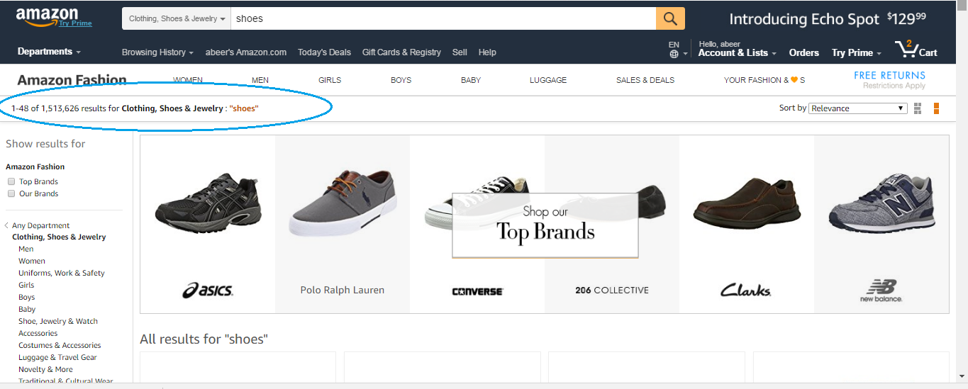
Problem Statement
Overwhelming Number of Choices

Slide 4
Problem Statement
Online Shopping Challenges
Overwhelming Number of Choices
Un-Personalized Content
Inaccurate Decision
High Cost for Finding Related Items.
Scale-up Graph to Handle Millions of Products
Notes:
On the Internet, where the number of choices is overwhelming, there is need to filter, prioritize and efficiently deliver relevant information in order to alleviate the problem of information overload, which has created a potential problem to many Internet users.
Recommender systems solve this problem by searching through large volume of dynamically generated information to provide users with personalized content and services.

Slide 5
RECOMMENDER APPROACHES
TRADITIONAL RECOMMENDER APPROACHES
Content-based filtering
Collaborative filtering
MODERN RECOMMENDATION APPROACHES
Context-aware approaches
Semantic based approaches
Notes:
TRADITIONAL RECOMMENDER APPROACHES
Content-based filtering
Content-based recommender systems work with profiles of users that are created at the beginning. A profile has information about a user and his taste. Taste is based on how the user rated items. Generally, when creating a profile, recommender systems make a survey, to get initial information about a user in order to avoid the new-user problem.
Collaborative filtering
Collaborative filtering became one of the most researched techniques of recommender systems. The idea of collaborative filtering is in finding users in a community that share appreciations. If two users have same or almost same rated items in common, then they have similar tastes. Such users build a group or a so called neighborhood. A user gets recommendations to those items that he/she hasn’t rated before, but that were already positively rated by users in his/her neighborhood.
MODERN RECOMMENDATION APPROACHES
Context-aware approaches
Context is the information about the environment of a user and the details of situation he/she is in. Such details may play much more significant role in recommendations than ratings of items, as the ratings alone don’t have detailed information about under which circumstances they were given by users. Some recommendations can be more suitable to a user in evening and doesn’t match his preferences in the morning at all and he/she would like to do one thing when it’s cold and completely another when it’s hot outside.
Semantic based approaches
Most of the descriptions of items, users in recommender systems and the rest of the web are presented in the web in a textual form. Using tags and keywords without any semantic meanings doesn’t improve the accuracy of recommendations in all cases, as some keywords may be homonyms. That’s why understanding and structuring of text is a very significant part recommendation. Traditional text mining approaches that base on lexical and syntactical analysis show descriptions that can be understood by a user but not a computer or a recommender system.That was a reason of creating new text mining techniques that were based on semantic analysis. Recommender systems with such techniques are called semantic based recommender systems.

Slide 6

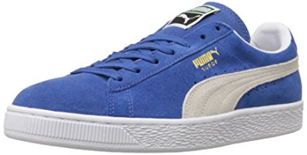
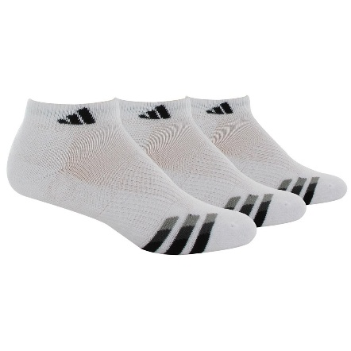
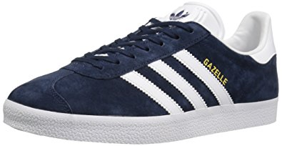
Business Understanding
Engine
User Looking for shoes
2) Recommending shoes
4) Puma with better price
6) Recommended
3) checking this shoes
5) Add to cart
Supplementary
Complementary
Notes:
In a modern recommender system, it is important to understand how products relate to each other. For example, while a user is looking for mobile phones, it might make sense to recommend other phones, but once they buy a phone, we might instead want to recommend batteries, cases, or chargers. These two types of recommendations are referred to as substitutes and complements: substitutes are products that can be purchased instead of each other, while complements are products that can be purchased in addition to each other.
Here we develop a method to infer networks of substitutable and complementary products. We formulate this as a supervised link prediction task, where we learn the semantics of substitutes and complements from data associated with products. The primary source of data we use is the text of product reviews, also makes use of prices, and brands. Methodologically, we build topic models that are trained to automatically discover topics from text that are successful at predicting and explaining such relationships. Experimentally, we evaluate our system on the Amazon product catalog.
Business Understanding
Recommender systems are ubiquitous in applications ranging from e-commerce to social media, video, and online news platforms. Such systems help users to navigate a huge selection of items with unprecedented opportunities to meet a variety of special needs and user tastes. Making sense of a large number of products and driving users to new and previously unknown items is key to enhancing user experience and satisfaction.
While most recommender systems focus on analyzing patterns of interest in products to provide personalized recommendations, another important problem is to understand relationships between products, in order to surface recommendations that are relevant to a given context. For example, when a user in an online store is examining t-shirts she should receive recommendations for similar t-shirts, or otherwise jeans, sweatshirts, and socks, rather than (say) a movie even though she may very well be interested in it. From these relationships we can construct a product graph, where nodes represent products, and edges represent various types of product relationships. Such product graphs facilitate many important applications: Navigation between related products, discovery of new and previously unknown products, identification of interesting product combinations, and generation of better and more context-relevant recommendations.
Despite the importance of understanding relationships between products there are several interesting questions that make the problem of building product graphs challenging: What are the common types of relationships we might want to discover? What data will allow us to reliably discover relationships between products? How do we model the semantics of why certain products are related?—For example, the semantics of why a given t-shirt might be related to a particular pair of jeans are intricate and can only be captured by a highly flexible model. And finally, how do we scale-up our methods to handle graphs of millions of products and hundreds of millions of relations?
Inferring networks of product relationships. Here we are interested in inferring networks of relationships between millions of products. Even though our method can be used to learn any type of relationship, we focus on identifying two types of links between products: substitutes and complements. Substitutable products are those that are interchangeable—such as one t-shirt for another, while complementary products are those that might be purchased together, such as a t-shirt and jeans.

Slide 7
Data Understanding
meta_Baby
asin (id)
price, company
qa_Baby
asin (id)
reviews_Baby_5
asin (id)
also viewed products
also bought products
description
title
question
answer
review
reviewer name
review time
rating
Data is extracted from “Amazon Baby Products”
Notes:
Data Understanding
We used a data extracted from amazon (Baby products data).
3 files:
meta_Baby contains the main data about the product
asin (id)
price, company
also viewed products
also bought products
description
title
qa_Baby contains questions and answers about the products
asin (id)
question
answer
reviews_Baby_5 contains the reviews written by users on the product
asin (id)
review
reviewer name
review time
rating
Notes:
Some data is incomplete, some products has no text.
Merging all the text will give a well sized text for the product
so we merged description, title, questions, answers and reviews for each product to form a one large text for each product

Slide 8
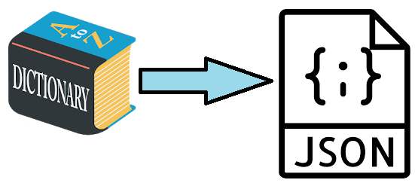
Data Preparation (PySpark)
Notes:
The Files we got are in the Dict python serialization format So first we Changed them into JSON format contains fields needed:

Slide 9
Data Preparation
meta_Baby
qa_Baby
reviews_Baby_5
Large Merged Document
Notes:
All the text aggregated into one large Doc for each product

Slide 10

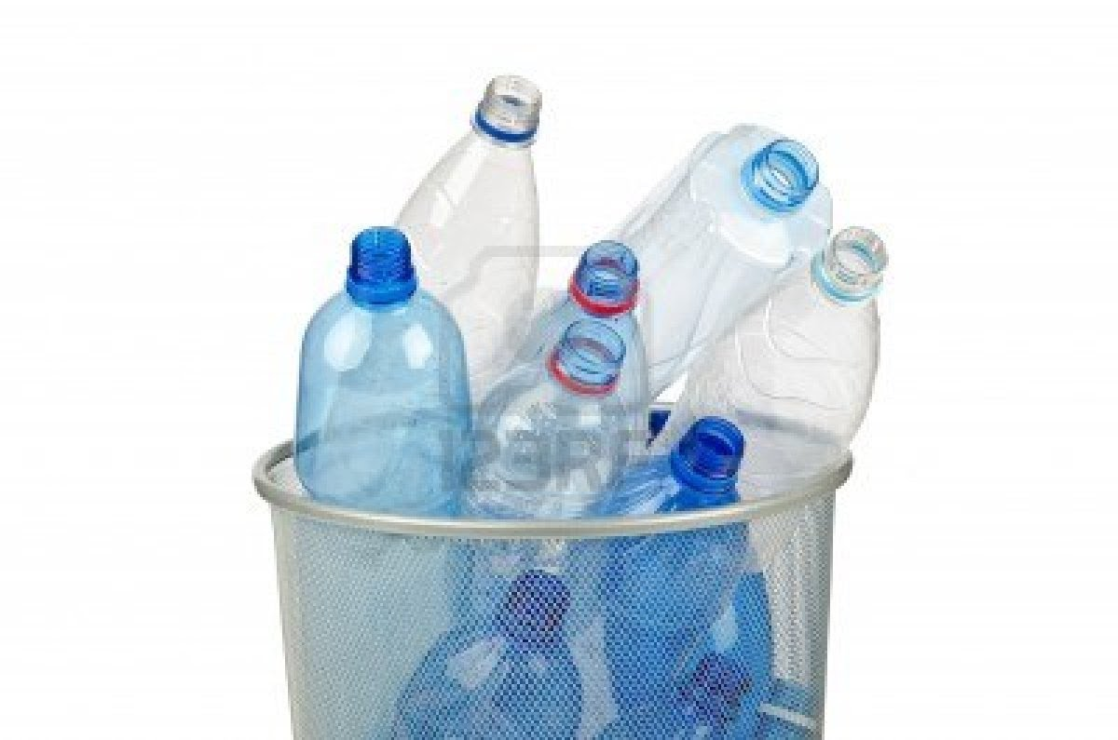
Data Preparation
Notes:
Products has null or zero length doc are filtered out

Slide 11
Data Preparation
Relations Depend on Also Viewed and Also Bought Data
Replicate Some No Related Data
Notes:
Create the relations depending on also viewed and also bought data
The also viewed data are considered as supplementary
The also bought data are considered as complementary
Replicate some no related data size of products that has no also viewed nor also bought data is very small (just 10 %) we created a not related products data from those products
for every product we selected 10 random products from the whole data
create 10 not related products rows from the ids of the products
Goals achieved by this step
Now data is ready for the Text Mining step
extra not used data in our algorithm are filtered out from the data
empty useless products (has no reviews nor description ) are filtered out

Slide 12
Evaluation
Error 11.79%
Accuracy 88.21%

Slide 13
Model Building
Text Mining
LDA (Latent Dirichlet Allocation)
Logistic Regression
Graph Creation

Slide 14
Deployment on Spark
LDA
Java- MLlib
Logistic Regression
Pyspark
Graph
Graphx- Scala

Slide 15
Graph (Graphx)
Vertex
Directed Edge
Undirected Edge
Weight

Slide 16
Products Relation using Graphx
Pampers
Baby Diapers
Supplementary
Complementary
Luvs Baby Diapers
Complementary
Baby Wipes
Baby Shampoo
Complementary
Complementary
Notes:
Strengths of the relation
Type of relation
Relation direction

Slide 17
References
J McAuley, R Pandey, and J Leskovec Inferring Networks of Substitutable and Complementary Products. Sydney, NSW, Australia — August 10 - 13, 2015
http://www.sciencedirect.com/science/article/pii/S1110866515000341
https://spark.apache.org/graphx/
https://en.wikipedia.org/wiki/Graph_(discrete_mathematics)
http://interactivepython.org/courselib/static/pythonds/SortSearch/searching.htmlhttp://interactivepython.org/courselib/static/pythonds/Graphs/VocabularyandDefinitions.html

